Slide 1

Credit Score Classification Using Machine Learning
Team Members
Manichandra Domala
Vedanth Reddy Doddannagari
Shashank Madipelly

Slide 2
Introduction
Credit scoring is a crucial process in the financial industry that assesses the credit worthiness of individuals or entities.
Lenders use credit scores to assess the risk associated with lending money to a particular individual or entity.

Slide 3
Problem & Objective
Problem Statement: The task at hand is to classify credit scores into categories such as Poor, Standard, and Good using machine learning techniques.
Objective: This presentation aims to explore how machine learning can be leveraged to automate the credit scoring process, thereby improving efficiency and accuracy.

Slide 4
Overview of Data
We collected the credit card data from Kaggle which is used to train and test the model.
And the data contains 100,000 rows and 28 columns.
This data is made up of 1200 customers data over a period of year
ID,Customer_ID,Month,Name,Age,SSN,Occupation,Annual_Income,,Monthly_Inhand_Salary,Num_Bank_Accounts,Num_Credit_Card,Interest_Rate,Num_of_Loan,type_of_Loan. Delay_from_due_date,Num_of_Delayed_Payment,Changed_Credit_Limit,Num_Credit_Inquiries,Credit_Mix,Outstanding_Debt,Credit_Utilization_Ratio,Credit_History_Age,Payment_of_Min_Amount,Total_EMI_per_month,Amount_invested_monthly,Payment_Behaviour,Monthly_Balance,Credit_Score
And the data is preprocessed to train and test model.

Slide 5

Data Pre-Processing
Handling Null values
1
Correcting the Data types of features
2
Handling Data Formats
3
Handling Categorical Features
4
Dropping unnecessary Features
5
Splitting the data into Training and Testing datasets
6

Slide 6
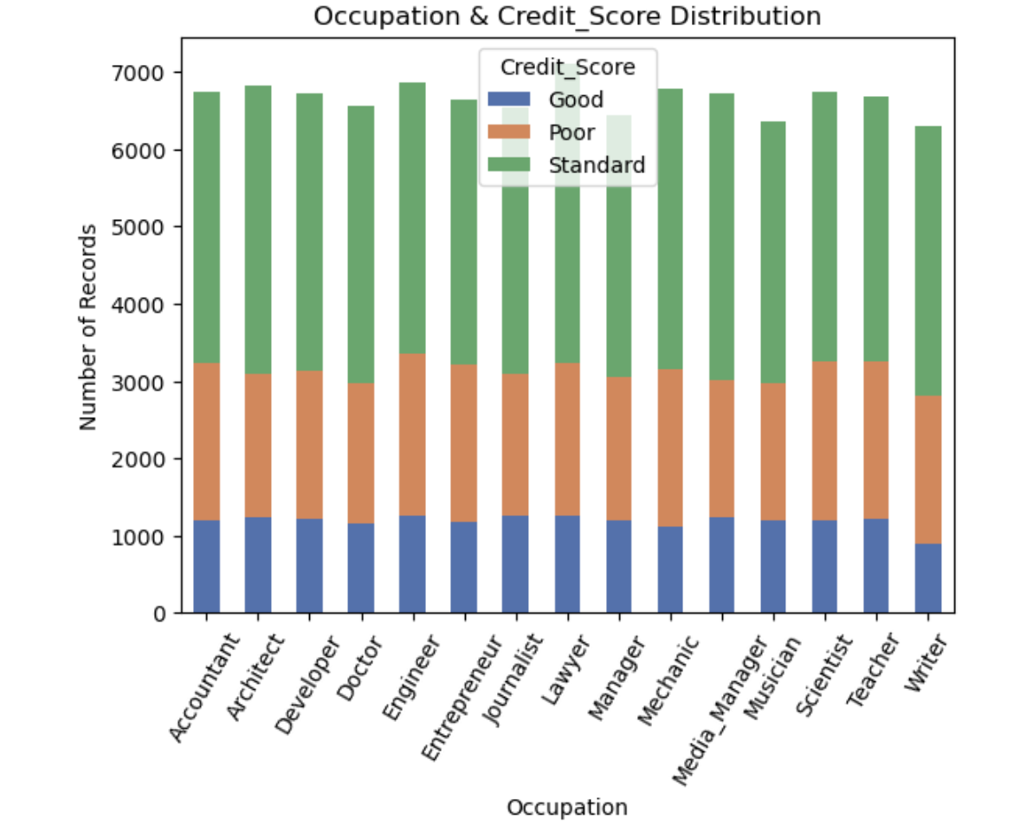
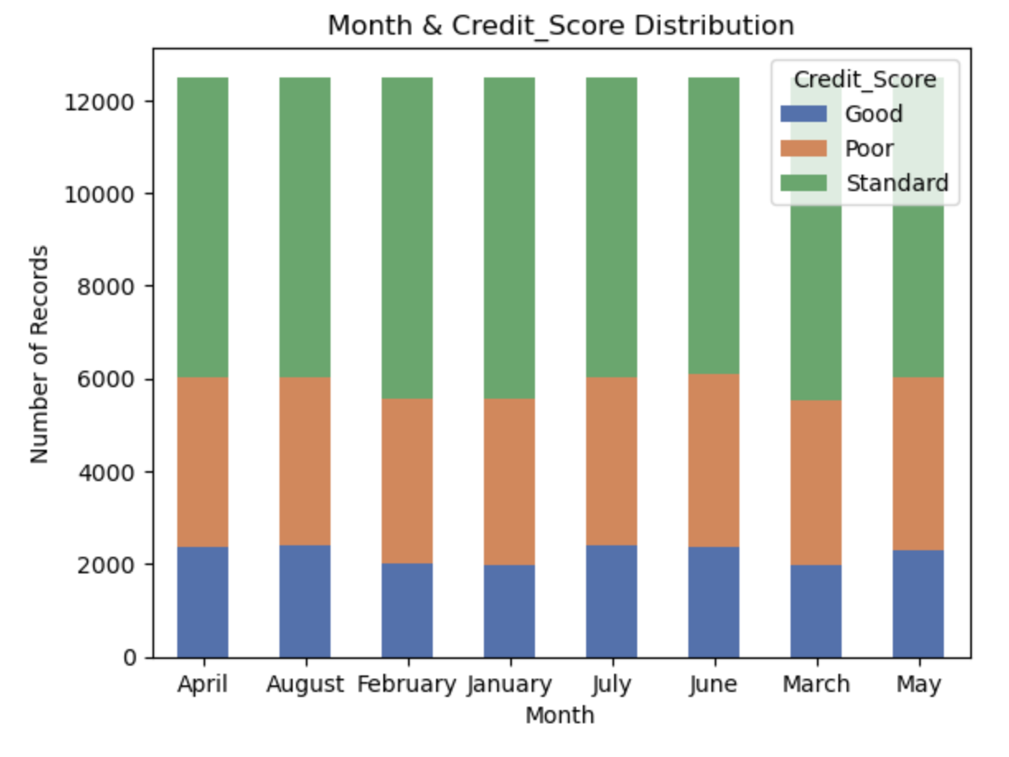
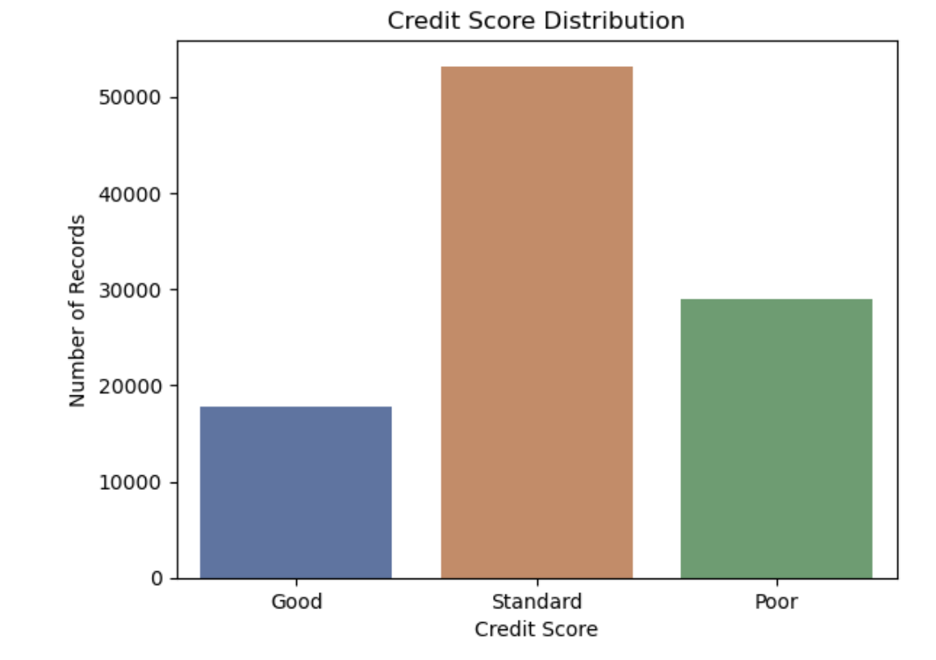
Data Visualization

Slide 7
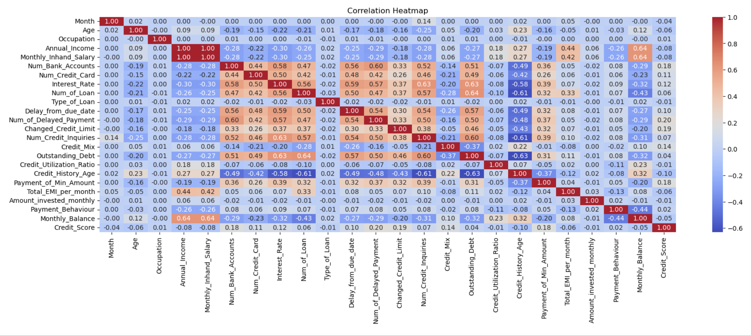
Correlation

Slide 8
ML Models
Decision Tree Classifier
Random forest Classifier
KNN
Gaussion NB

Slide 9
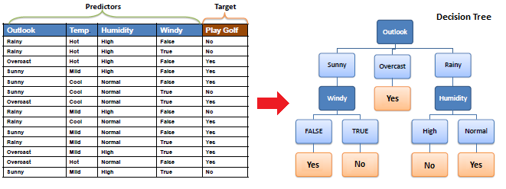
Decision Tree Classifier
Decision Tree Classifier: A machine learning algorithm that partitions the feature space into segments, making decisions based on feature values at each node.

Slide 10
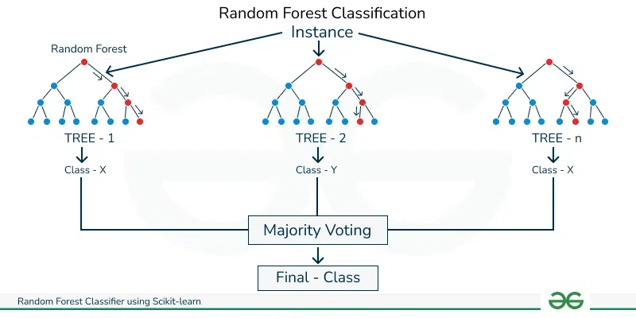
Random Forest Classifier
Random Forest Classifier: An ensemble learning method that builds multiple decision trees and combines their predictions to improve accuracy and reduce overfitting.

Slide 11
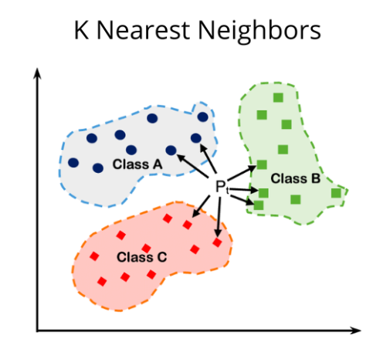
K-Nearest Neighbours (KNN)
K-Nearest Neighbours (KNN): A simple algorithm that classifies data points based on the majority class of their k nearest neighbours in feature space.

Slide 12
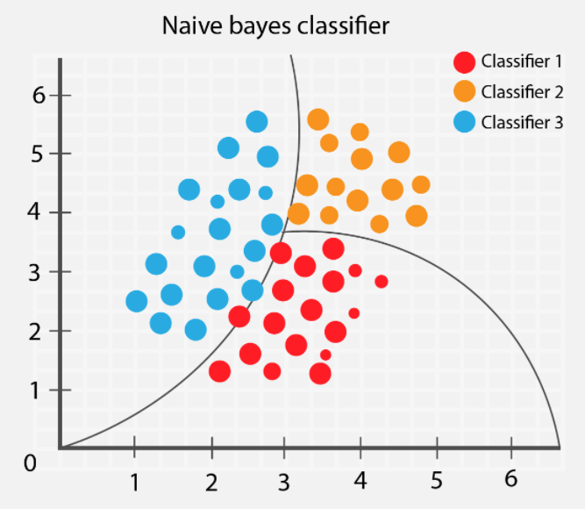
Gaussian Naive Bayes (NB)
Gaussian Naive Bayes (NB): A probabilistic classifier based on applying Bayes' theorem with the assumption of independence between features, often used for classification tasks with continuous input features

Slide 13
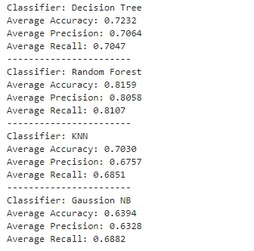
Evaluation
These are the evaluation metrics used to analyze and select best model.
Accuracy is the proportion of correctly classified instances among the total instances;
Precision is the proportion of true positive predictions among all positive predictions;
Recall is the proportion of true positive predictions among all actual positives.

Slide 14
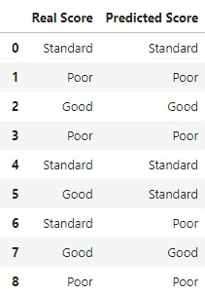
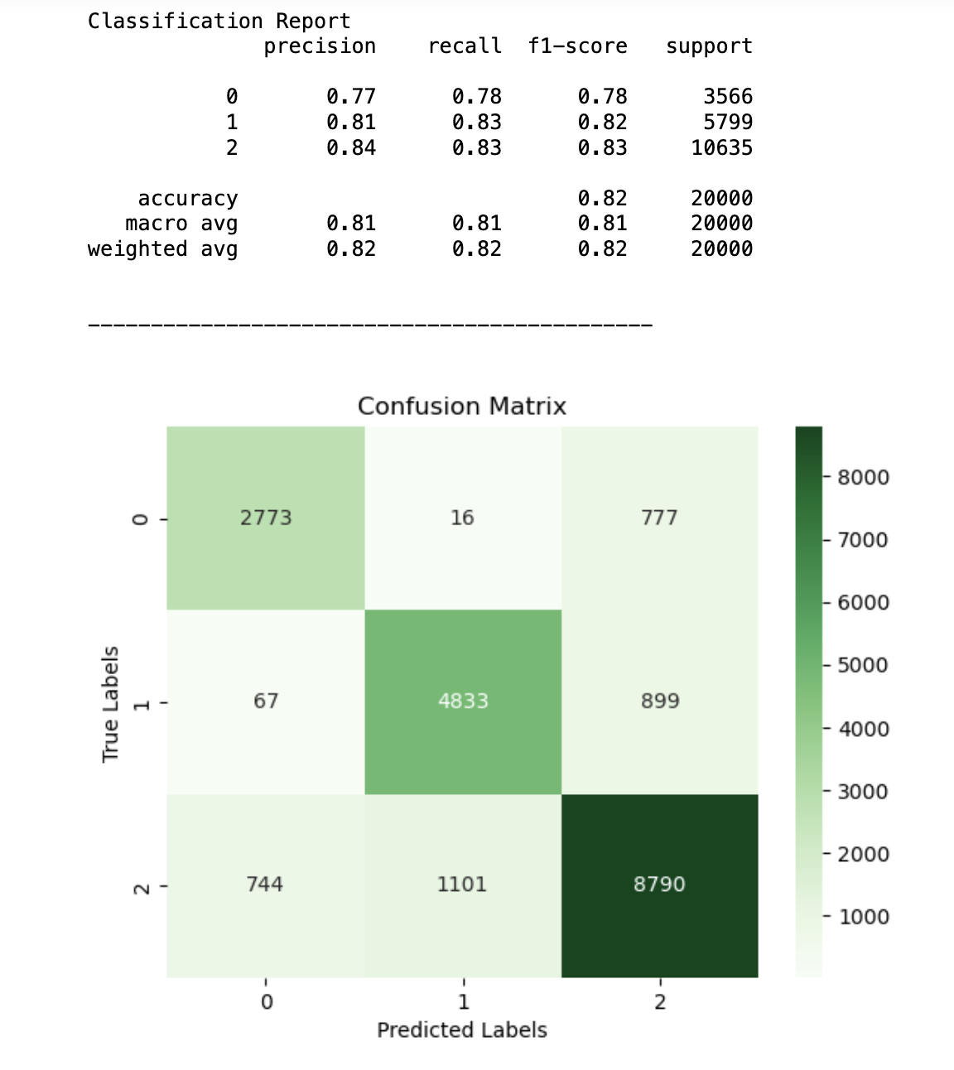
Results

Slide 15
Reference
https://www.linkedin.com/pulse/top-6-machine-learning-algorithms-classification-jagrat-patel/
https://www.kaggle.com/datasets/parisrohan/credit-score-classification/data
https://www.javatpoint.com/machine-learning-algorithms

Slide 16
THANK YOU

